Slide 1
Information Governance in SharePoint
Eleonora Babayants
Galaxy Consulting

Slide 2
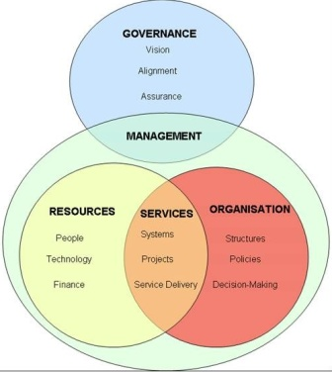
Information Governance
It is the set of policies, procedures, processes, roles, metrics, and controls implemented to manage information.
Supports regulatory, legal, risk, and operational requirements.
Should be based on a company specific requirements.
Consider governing body – executives, IT, division leaders, compliance, legal.
Develop initial principles and goals – metadata, templates, guidelines, compliance, training, branding. Be clear about roles.
Develop educational strategy – formal and outgoing.
Develop an ongoing plan and measure against original principals and goals.
Top-down support is critical.
Define procedures with users feedback.

Slide 3
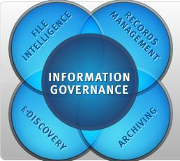
Information Governance Methods
Content types – determine what you will upload into your CMS;
Document owners – determine and enter into metadata;
Retention schedule – define by document type and set up workflow to alert the administrator;
Change management and control – no changes without approval;
Naming conventions – for each document type;
Approval and publishing documents – to verify the content before it has been published;
Time for checked out documents – define and enforce;
Permissions – set up users group and assign them to document types.

Slide 4
Information Governance in SharePoint
What to govern:
Sites – growth of server, size of uploaded documents and their longevity, block some file types, for example exe files.
Asset classification – develop classification for your site collections and sites and associate business value to them.
Lifecycle management – identify active and unused sites.
Branding and templates – choose templates.
Information architecture - metadata, taxonomy, navigation.
Records management – retention schedule.

Slide 5
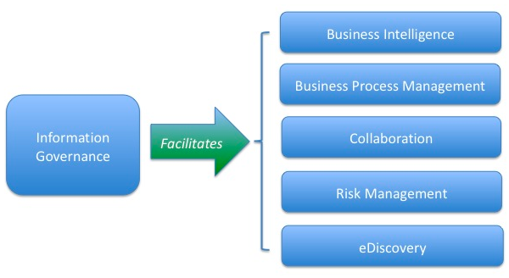
Information Governance in SharePoint
Content types – consistent metadata, workflows, policies.
Content approval – control the publication of content.
Information management policies:
Auditing – logs events such as editing and viewing documents.
Expiration – set a content type to expire on a certain date and a workflow.
Labeling – searchable text, specifies a label to associate with a type of document or list item based on metadata.
Barcode - to track a physical copy of a document.

Slide 6
Eleonora Babayants
Email: eleonora@galaxyconsulting.net Office: 650-474-0955
Mobile: 650-716-3609
www.galaxyconsulting.net
Twitter: GalaxyConsult
Facebook: Facebook.com/GalaxyConsult

