Slide 1
Take Knowledge Management to the Next Level: Advanced Processes and Techniques for Optimal Information Sharing
Eleonora Babayants
Galaxy Consulting

Slide 2
Current Trends in Knowledge Management
Technology for Knowledge Management
Technology Options
Software/System Update
3. Knowledge Management Processes
Cultural Resistance
Knowledge Capture Strategies
Collaboration
Knowledge-Centered Support (KCS)
User Adoption Strategies
Training
Findability and Accessibility
Taxonomy
4. Governance, Risk, and Compliance
5. Analytics and Reporting
6. Q & A

Slide 3
Knowledge Management Overview
Definition:
Knowledge Management is a term that arose approximately two decades ago, roughly in 1990. It is the process of capturing, distributing, and effectively using knowledge.
Gartner Group:
"Knowledge management is a discipline that promotes an integrated approach to identifying, capturing, evaluating, retrieving, and sharing all of an enterprise's information assets. These assets may include databases, documents, policies, procedures, and previously un-captured expertise and experience in individual workers."
It is the process of managing knowledge of and in organizations.

Slide 4
Knowledge Management Trends
Big Data
Data sets whose size is beyond the ability of
commonly used software tools to capture,
manage, and process the data within a tolerable
elapsed time.
During last 10 years the volume and diversity of
information grew at unprecedented rates.
Amount of information is doubling every 18
months, and unstructured information volumes
grow six times faster than structured.
The growth of data continues to outpace
available storage capacity

Slide 5
Knowledge Management Trends
Big Data
Cisco study: global IP traffic will reach 1.3
zettabyes annually by 2016 which is fourfold
increase from 2011 (1 zettabyte = 1 trillion
gigabytes
By 2016 there will be 19 billion global network
connections, the equivalent of two-and-a-half
connections for every person on earth.
2020: 35 zettabytes (35 trillion gigabytes) =
a stack of DVDs reaching halfway to Mars

Slide 6
Knowledge Management Trends
Big Data
Challenges:
Capture
Storage
Search
Sharing
Analysis
Manage
Utilize

Slide 7
Knowledge Management Trends
Social Computing
Widely spread in the work place and is
integral part of enterprise productivity.
Gartner: by 2014 social networking
services will replace email for inter-
personal business communication for
20% business users.
Enterprise social software solutions are
being used in 67% of organizations
surveyed in 2013, up from 43% in 2011.

Slide 8
Knowledge Management Trends
Social Computing
Traditional content management and
collaboration solutions are incorporating
new features to satisfy the social and
information sharing demands of the
enterprise.
Tools: blogs, instant messaging, wikis, social
tagging and bookmarking, discussion boards
with comments fields.
Comment on case studies, exchange ideas,
and contribute material, follow up with
people, search for subject matter experts, get
updates on projects, participate in
conversations that are going on.

Slide 9
Knowledge Management Trends
Social Computing
Challenges:
Two-edged sword: knowledge sharing and
noise, volume ,and diversity of information
The question was: how much you want to
connect vs how much you want to collect?
The new version is: how much do you want to
curate vs not curate?
How much of it do you want to have control
over?
May impact ability to manage risk
Need to increase information control and
visibility
Need to understand, develop policies and
solutions to stay compliant

Slide 10
Knowledge Management Trends
Cloud Computing
Shift from capital-intensive model of buying and
running infrastructure and software to renting
usage of shared infrastructure and applications
Can purchase software as a service (SaaS) that is
hosted online and completely scalable
Forrester predicts growth in SaaS applications.

Slide 11
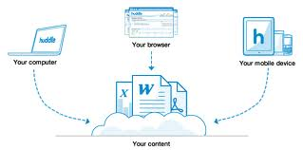
Knowledge Management Trends
Cloud Computing
Benefits:
Rapid deployment - no hardware or software to
install, no servers to buy, no setup time
Access anywhere – available any time, anywhere
Easy collaboration – access anywhere and
collaborate on content
Low cost – much less than on-premise solution
Speed - takes 24% of the time of similar on-
premise projects
Flexibility - right-sizing capacity, changing
business needs
Reduced risk - variety of protections can be written into vendor contracts
Effective mobile client

Slide 12
Knowledge Management Trends
Cloud Computing
Challenges:
Even the largest cloud vendors can
experience outages
Multiple file formats
Document size
Browser compatibility
Mobile viewing
Data ownership continuity, security,
compliance
Take test-based approach
Consider user experience

Slide 13
Knowledge Management Trends
Mobile Computing
Enables access from anywhere.
Forrester predicts: by 2016 smart phones and
tablets will be used by a billion of global
customers.
Employees and customers will expect and demand
that all business applications support mobility.
Need to be able to deliver mobile experience -
ability to access content from mobile devices.
Content and systems must be optimized for
mobile devices.
Employees working in the field must be able to
access content from their mobile devices.

Slide 14
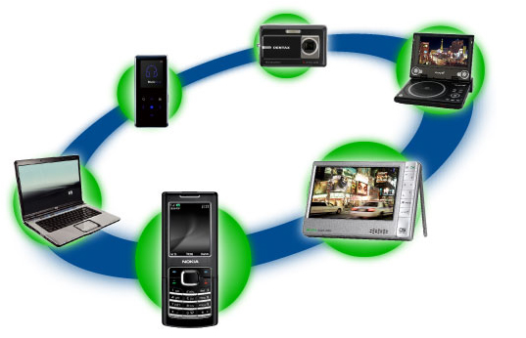
Knowledge Management Trends
Mobile Computing
Employees use mobile devices to collaborate on
docs, take meeting notes, create presentations,
and collect data in the field.
Decide what content and services make the
most sense for your organization mobile
devices.

Slide 15
Knowledge Management Trends
“Bring Your Own Device” (BYOD)
Employees bring iPads, iPhones , Androids,
Blackberrys to work
Benefit – cost savings to IT
Challenges:
Security, workflow, management issues for IT
Employees own devices, but they don’t own the
corporate data
Corporate data in the consumer-based public
cloud – cloud operator owns the data
Hackers - accessing corporate data
Define and control levels of access BYOD has to
a company networks, applications, and data.
Establish a comprehensive governance policy.

Slide 16
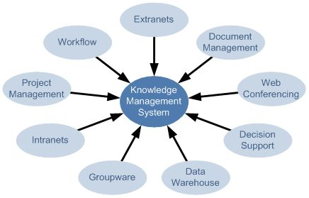
Technology for
Knowledge Management
Technology Options
There are many technology options to choose from.
Real Story Group – buyer's advocate for enterprises looking to invest in knowledge management technology, provides neutral evaluation
www.realstorygroup.com
Real Story Group 2012 Vendor Map:

Slide 18
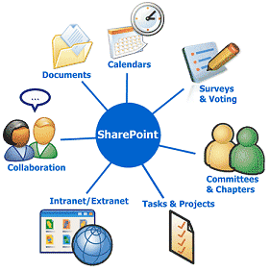
SharePoint
Broad platform of web technologies:
Intranet portals
Extranets
Web sites
Content management
Collaboration spaces
Social tools
Business intelligence
Project management
3rd-party solutions

Slide 19
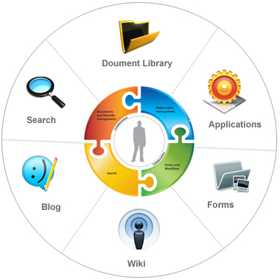
SharePoint
Licenses: capabilities, deployment, hosting
On-premise or in cloud
Microsoft updates it every 3 years
2013 version is already available
Is it good or bad?

Slide 20
SharePoint 2010
3 Editions in 2010 version:
Foundation – platform for all products,
contains all core functionality, available at no cost
Standard – builds on the Foundation
Enterprise – builds on the Standard
Changes:
New user interface - ribbon
New themes gallery
New co-authoring feature - allows few users to
work simultaneously on the same documents
Calendar - improved
Wiki – streamlined
Managing multiple items - improved

Slide 21
SharePoint 2010
Changes:
Blogs – improved authoring tools and navigation
Social Computing - new features: newsfeeds, social
tagging, and ratings;
Social Computing - “My Site” improved profiles
Mobile Devices – web pages and search optimized,
can subscribe to text messages with alerts
Off-line access - enables you to work while
disconnected from your corporate network and
then to synchronize your changes
Managed metadata service - to manage taxonomies
and metadata consistently
Document sets - enables creating and managing
documents that span multiple documents.

Slide 22
SharePoint 2010
Changes:
Records management – improved storage and
retention policies
Web content management improved
Search - FAST search engine is incorporated,
refined and improved search retrieval and search
results display.
Excel services improved
Infopath - can now be used to fully customize
list forms
Permissions - includes view and adjust
permissions, new permissions management from
every site collection, site, list or list

Slide 23
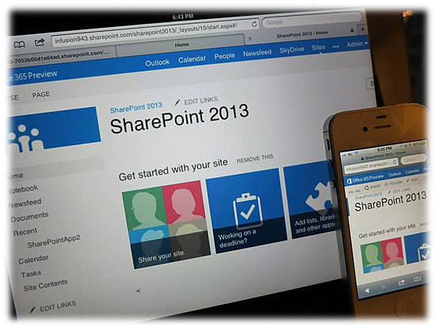
SharePoint 2013
Interface – “Metro”, very intuitive and simple
Themes - optimized
Libraries, lists, calendar are now called apps
Uploading documents – from home page, can drag
and drop
Re-use content across multiple sites
Navigation – ability to base navigation on an
existing set – centrally manage content
User-friendly links:
2010: www.contoso.com/Pages/Computers.aspx#/ID=453&Source=http%3A%2F1010101
2013: http://www.contoso.com/Computers/model101

Slide 24
SharePoint 2013
Social Features:
New - micro blogs, activity feeds, community sites,
Following, Likes , Ratings, Reputation Management,
private group conversations, community sites
Improved - discussion boards, My Site
Mobility – site access optimized
Search - further advantage of FAST , more relevant
search results, ability to filter search results, preview
of retrieved items
eDiscovery - ability to perform eDiscovery queries,
to preserve and export discovered content, and
support for search and export from file shares.

Slide 25
SharePoint 2013
Records management and compliance - retention
policies and compliance features can be applied at
the site level
Web Content Management - design of publishing
sites simplified, authoring and publishing
enhanced, search to surface dynamic web content
on publishing sites
Permissions – further simplified

Slide 26
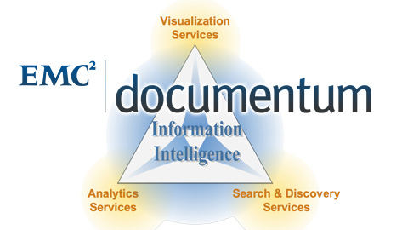
Documentum
Produced by EMC and includes:
Content Security - secure access to sensitive information – for email, Office, PDF
Digital Asset Management - for managing digital assets
Records Management - to control records lifecycle:
Documentum Standard – for enterprise content:
Documentum eRoom - online team collaboration
Documentum Platform – includes XML component management
Documentum Repository Services for SharePoint – redirect SharePoint content to Documentum repository
Documemtum xCP – high performance platform for enterprise content

Slide 27
Product of Interwoven, acquired by Autonomy, then by HP; component CMS. Includes:
ContentCenter Standard - portal with easy interface
ContentCenter Professional - portal with advanced interface
FormsPublisher - for structured, form-based content authoring
SitePublisher - a WYSIWYG content contribution interface with a reusable component based architecture
MediaBin Digital Asset Management Server - for digital assets management
MetaTagger - content intelligence services for automated metadata extraction and recommendation

Slide 28
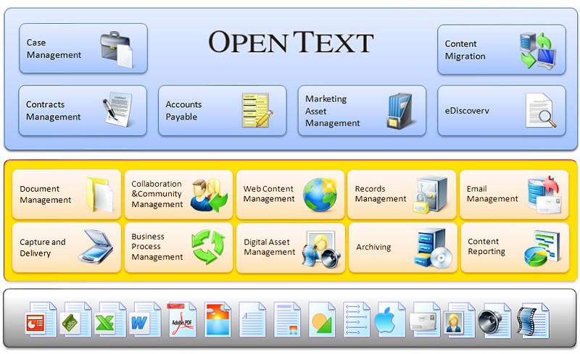
Open Text ECM Suite
Open Text ECM suite:
Document management - formerly Livelink - provides full lifecycle document management
Digital asset management
Records management
Web content management
eDocs – formerly Hummingbird
- for managing all forms of content; also includes collaboration, forums, blogs, wikis, instant messaging, and provides business process management tools

Slide 29
Formerly Stellent – is a component CMS, supports entire content lifecycle.
Includes:
web content management;
document management;
digital asset management;
records and retention management;
personalized content delivery;
categorization;
portal integration;
SharePoint integration;
document capture and scanning integration;
content conversion and transformation.

Slide 30
Component CMS
Web content management system
Proprietary BluePrinting Technology – reuse
and adapt content, layout, and other
functions for pages and websites
Provides an ability to edit content within the
context of web site
Can create pages, change text, update
images, drag and drop widgets in the preview
Includes multiple languages support

Slide 31
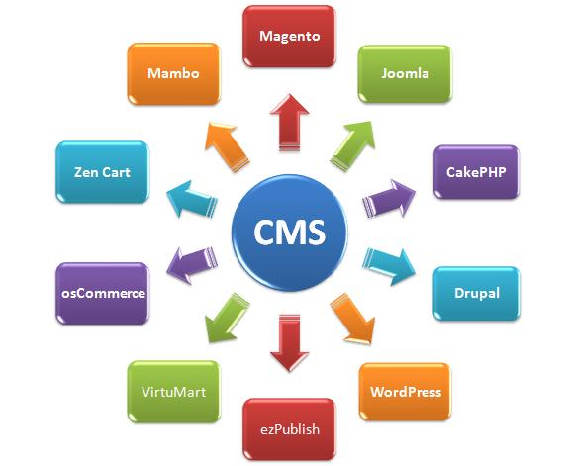
Open Source CMS
Drupal – used for web sites, knowledge management and collaboration.
Joomla – used for publishing content on the web and intranet.
Alfresco – enterprise content management system, includes: document management, web content management system, records management, content platform, collaboration. It has been selected by KM World as trend-setting product.

Slide 32
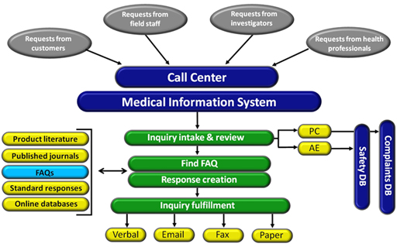
Information Request Management System (IRMS)
Medical information software – produced by OBA - for handling medical communications; allows to record requests for information and responses
Utilizing a shared database (Oracle, SQL, MS Access) to store request data and standard response documents
Includes FAQ management, contact management, content management, adverse events, product complaints modules
Integrates with Siebel for CRM and
FDA and CFR 21 compliant and validated

Slide 33
Technology Products
CaptureIt – product of AnyDoc Software (anydocsoftware.com) – stand-alone
document capture application.
Autonomy IDOL – product of Autonomy(autonomy.com) - stands for
“'Intelligent Data Operating Layer”. It is the enterprise search engine.
Knowledge Management Suite – product of Bamboo Solutions
(bamboosolutions.com) – extends SharePoint’s capabilities for collaborative
knowledge management.
Smart Content Framework – product of Concept Searching
(conceptsearching.com) – KM World Promise Award Winner - provides
platform independent statistical metadata generation through concept
extraction and compound term processing .
Content Shield – product of AvePoint (avepoint.com) – works to ensure that
SharePoint is fully compliant with regulations and internal protocols.

Slide 34
Technology Products
Coveo (coveo.com) – enterprise search engine.
Data Harmony suite of tools – product of Access Innovations (accessinn.com) –
provides semantic control and enrichment, enabling information to be found
accurately and quickly.
Jive Software (jivesoftware.com) – comprehensive tools for collaboration,
communication, content creation and sharing.
DotImage Enterprise Edition – product of Kofax (kofax.com) – provides
document capture for pertinent documents, forms, faxes.
Social Site for SharePoint – product of Newsgator (newsgator.com) – social
networking for SharePoint integration.
Proofpoint (proofpoint.com) – tracks, classifies, monitors, and applies policy to
unstructured information across the enterprise where stored.

Slide 35
Technology Products
Aspire – product of Search technologies (searchtechnologies.com) – content
processing system designed for search, enabling content to be acquired, cleaned,
restructured, enriched and normalized.
Semaphore - product of SmartLogic (Smartlogic.com) - combines ontology
management, classification, text mining and semantic analysis in a search
application framework.
Synaptica Enterprise – product of Synaptica (synaptica.com) - taxonomy and
metadata management software.
Velocity – product of Vivisimo which is IBM Company (vivissimo.com) –
enterprise search engine

Slide 36
Technology for
Knowledge Management
Software/System Update
GMP/GxP requirements for IT
Validation
Existing systems
Security certification
Company policies, budget, timeline

Slide 37
Knowledge Management Processes
Cultural Resistance
Changes in the corporate culture are required
Cultural resistance reasons:
KM has not become a culture and behavior
Lack of understanding and awareness of
management of importance of KM;
Management see KM as burden and don’t see it
helping to increase efficiency and productivity
Absence of KM processes
No consistency in enforcement of KM processes
Resistance to change
Difficulties in using KM systems
Too many tasks on employees to-do list
KM is not part of employees work tasks
Lack of training

Slide 38
Knowledge Management Processes
Cultural Resistance
KM and Governance →Top –Down approach,
Enterprise approach and central KM group
Clear business plan
Identify value proposition for leadership and
employees
Expertise location, content management,
collaboration
Key best practice – reusability
Deployments can come in stages over time

Slide 39
Knowledge Management Processes
Cultural Resistance
Strategies to overcome cultural resistance to KM:
Top down approach, bottom up approach will not work;
senior leadership needs to commit to KM
Start with management, educate them
Create KM processes and workflows
Make knowledge sharing part of employees annual performance review. Formally reward them.
Include KM into the new employee on-boarding
Use recognition and awards to promote a continuously
learning culture
Make it easy to document knowledge, e.g. create
templates and make it easy to upload documents into
your KM system

Slide 40
Knowledge Management Processes
Cultural Resistance
Make documenting part of formal product release
Make KM centralized effort, again connected to top-
down approach
Make KM is a part of employees work tasks
Training

Slide 41
Knowledge Management Processes
Knowledge Capture Strategies
Convert tacit knowledge into implicit knowledge and
then into explicit knowledge = Content
Assess knowledge - before, during, or after KM-related
activities
Successful KM strategy - actively managing knowledge
Making knowledge requests of experts
Proximity & architecture - the physical situation of
employees can be either conducive or obstructive to
knowledge sharing
Knowledge sharing behavior – collaboration, outreach,
documenting know-how, effective content management,
knowledge-centered support

Slide 42
Knowledge Management Processes
Knowledge Capture Strategies
Knowledge management strategies and instruments
include:
Rewards
Storytelling
Cross-project learning
After action reviews
Knowledge mapping (a map of knowledge repositories
within a company accessible by all)
Communities of practice
Expert directories
Best practices transfer

Slide 43
Knowledge Management Processes
Knowledge Capture Strategies
Knowledge management strategies and instruments :
Knowledge fairs
Competence management
Master-apprentice relationship
Reporting intellectual capital
Knowledge brokers
Inter-project knowledge transfer

Slide 44
Knowledge Management Processes
Collaboration
Email still…
Work together to create a deliverable
Collaboration applications
Need simple, secure, and rapid access to information
regardless of source, format, platform or storage
media, geographic location
Workflows for document collaboration

Slide 45
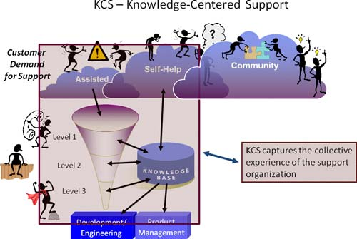
Knowledge Management Processes
Focus on knowledge as a key asset
While KCS is enabled by technology, KCS
is primarily about people
Perspective – knowledge = asset owned by
team and not individual
Process:
Create content as a by-product of solving problems
Evolve content based on demand and usage → review and fix
Develop a knowledge-base → Draft Knowledge
Knowledge re-use → Trusted Knowledge, approved for internal use or self-service

Slide 46
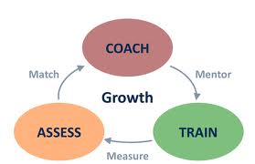
User Adoption Strategies
Knowledge Management Processes
User adoption is progressive, not a single event,
happens in phases
Expose new features and move users to new
levels of product adoption over time
To persuade a user to adopt an additional
feature -→ affect the user’s perception of the
feature’s usefulness, ease of use, sense of
security concerning that feature
Demonstrate that it is easy and consistent with
what the user already knows or already does
Let the user try it in safe, verifiable increments
Look – overwhelming and busy = ultimate want
in manageable steps → Progressive user
adoption → Orchestrated sequence of exposures
to the product’s functionality

Slide 47
User Adoption Strategies
Knowledge Management Processes
Well-formulated progressive user adoption strategy :
1. Identify core functionality
2. Make the core functionality bulletproof from a
usability perspective
3. Identify progressive adoption sequences that go
from core functions to advanced functions.
4. Construct product interventions to move users
to advanced functionality
Need to increase users’ confidence and trust in the system as a whole.

Slide 48
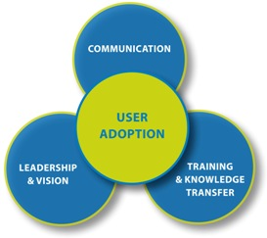
Knowledge Management Processes
Explain benefits before deployment.
Collect user requirements and create use cases.
Build based on users requirements – user-centered
design.
Provide assurance of training and assistance.
Make everything very easy and very intuitive.
Point out benefits and usefulness – how it
is better than what a user is doing now.
Provide training early on.
Provide documentation.
Demonstrate that it is easy and consistent with
what the user already knows or already does.
Let the user try it in safe, verifiable increments.

Slide 49
Knowledge Management Processes
Training
Training requirement in the regulated environment
Training on KM processes and procedures as well as
on KM system functions
Mandatory part of user adoption strategy
Provide individual and group training
Schedule group training at the same time and at the
same place
Market training
Provide lunch and/or refreshments if your budget
affords it
Make it “brown bag”
Learning Management System (LMS)
Add knowledge management training curriculum
to the mandatory training and enter it into LMS.

Slide 50
Knowledge Management Processes
Findability and Accessibility
Single repository for the creation, presentation, and
management of all content regardless of where it
originally resides
Single point of access for users to access all enterprise
content.
Simple, secure, and rapid access to information
regardless of source, format, platform or storage
media, geographic location.
Have a unified presentation platform for all content
and ensure that it is subject to enterprise search
Provide administration of systematic metadata
tagging

Slide 51
Knowledge Management Processes
Findability and Accessibility
Provide 2 access points - browsing and search
Consistent metadata is required in order for search to
work properly
Taxonomy is required for successful browsing
Provide consistent naming conventions
Provide consistent navigation. It should be clean and
simple
Give labels intuitive names and place them in
consistent places
Do not make users to make too many clicks
Good navigation system

Slide 52
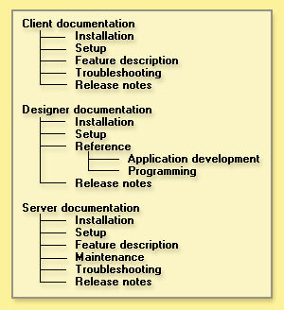
Taxonomy
Knowledge Management Processes
Taxonomy is a hierarchical structure for the classification and organization of content
Taxonomy is very important for navigation and browsing
Taxonomy development requires cooperation of departments
Successful taxonomy – not too deep and not too wide
There is no such thing as finished taxonomy
Create taxonomy before you upload content into a system
Consider taxonomy management tools
Information today needs to be indexed within context
Index conversations

Slide 53
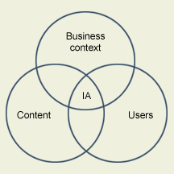
Taxonomy
Knowledge Management Processes
There are three key factors in taxonomy development: business context, content, and a user.
Business Context - What is the purpose of the taxonomy? How is the taxonomy going to be used?
Content - What is the content scope? Possibilities include companywide, within an organizational unit, etc.
What content sources will the taxonomy be built upon?
User - Who will be using the taxonomy? Possibilities include employees, customers, partners, etc. What are the user profiles?
Construct taxonomy with users feedback.

Slide 54
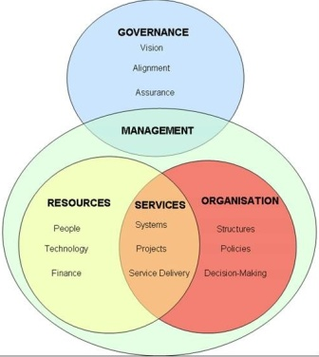
Governance, Risk, and Compliance
Governance is an insurance policy
KM can be costly in terms of fines, brand
reputation, legal fees
Focus is on risk management – understand and
manage risk - Enterprise Risk Management
(ERM)
Where to begin?
Steering committee
Outline the scope, timeline, budget
Should be rolled out from the top
Have a strategy and policies
Rank value of information

Slide 55
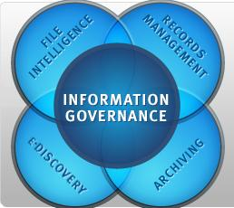
Governance, Risk, and Compliance
What needs to be considered?
Government mandates
Proliferation of content
Big data
Cloud computing
Mobile Devices
Social media
BYOD phenomena
Security
Intellectual property
Crisis management
E-Discovery

Slide 56
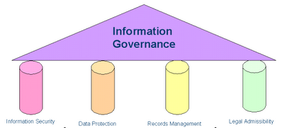
Governance, Risk, and Compliance
Governance Controls:
Understand your data topology
Employ real-time indexing of content
Store the intelligence about your content (metadata)
Create an info intelligence service center
Employ change management
Become proactive in deploying policies
Remove obsolete or unnecessary content
Define content life cycle and retention policies
Tier your access
Educate the organization on the value of good
governance
Categorize your information and determine its
value and rank

Slide 57
Governance, Risk, and Compliance
Perform content approval
Retention schedule, content controls, consistent
disposition of content
Keep track of what info is created, stored, and
accessed.
Auto classification and semantic tools within the
search engines.
Move relevant docs from desktops and shared
drives to your central docs repository.
Efficient document versioning and check-
in/check-out management for information
consistency
Robust administration of users to ensure that
each as access rights for only documents that
they are authorized to have access to.

Slide 58
Analytics and Reporting
Satisfactory user experience depends on knowing about
visitors - evolve clear metrics
Need to know what parts of your web site or system users
are visiting, trends, activities, adoption curve
Monitor users activity and reaction to new content
Tools:
Omniture
WebTrends
Unica
CoreMetrics
Site Catalyst
Google Analytics

Slide 59
Q & A
Questions ?

Slide 60
Eleonora Babayants
Email: eleonora@galaxyconsulting.net Office: 650-474-0955
Mobile: 650-716-3609
www.galaxyconsulting.net
Twitter: GalaxyConsult
Facebook: Facebook.com/GalaxyConsult

